Slide 1
t-SNE

Slide 2
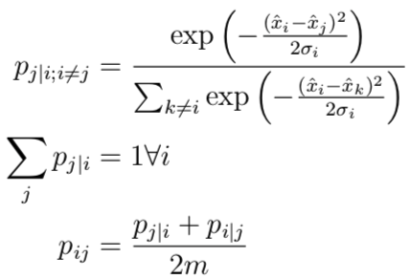
t-dist. Stochastic Neighbor Embedding
Implementation
Find similarities between data points in original space

Slide 3

t-dist. Stochastic Neighbor Embedding
Implementation
Find similarities between data points in original space
found through finding where perplexity of prob. dist. equals pre-defined perplexity
Perplexity generally dictates how many neighbors to consider when finding the conditional probabilities
Required to scale both with noise and dataset size
Notes:
More data means larger perplexity to consider a larger part of the neighborhood, more noise means need to consider more neighbors to not be overwhelmed by noise

Slide 4
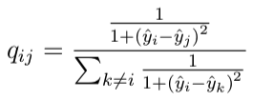
t-dist. Stochastic Neighbor Embedding
Implementation
Find similarities between data points in original space
found through perplexity
Learn lower dimensional map that reflects higher dim. prob. dists as best as possible

Slide 5

t-dist. Stochastic Neighbor Embedding
Implementation
Find similarities between data points in original space
found through perplexity
Learn lower dimensional map that reflects higher dim. prob. dists as best as possible
Find y_i through minimizing Kullback-Leibler (KL) Divergence

Slide 6

Algorithm additions
After finding joint probability distributions in original space, joint probability matrix is multiplied by a factor (early exaggeration) before optimization stage
This helps separate clusters even more

Slide 7
Algorithm additions
After finding joint probability distributions in original space, joint probability matrix is multiplied by a factor (early exaggeration) before optimization stage
Angle says how much of a region can be approx. to a single point
Speed vs accuracy tradeoff

Slide 8
Barnes-Hut
Faster speed, but is an approximation, requires dense input
Only works when embedding dimensions is 3 or less
Scales better (can work at 100k data points, exact method only up to around 1k)

Slide 9
Considerations
KL divergence is not convex, so different initializations can lead to different results
Iterate over different initialization states and choose the result with the lowest loss
Focuses on finding local structures
Good when there are several different manifolds in the dataset
Perplexity adapts sigma_i based on prob. dens.
Not so good at unfolding a single manifold
In high original dimensions distances should be changed for euclidean to intrinsic geometric

Slide 10
Considerations
Because some of our algorithms used nearest neighbor based approaches, it can lead to better performance if we perform feature scaling before dim. Red.
Beware of noisy data, increasing neighborhood size is good for dealing with noise/sparseness, decreasing size helps better capture local structure
Singular matrices can also arise from duplicate data points, beware of those. Otherwise look to increase neighborhood size

